Slide 1

Game Theory

Slide 2
بسم الله الرحمن الرحیم

Slide 3


Contents:
Page Title
5
6
12
15
19
20
21
23
28
29
What is game Theory?
Game Components
Nash Equilibrium
Examples
Strict Nash Equilibrium
Provision of a Public Good
Best Response Functions
Duopoly
Match
Auctions

Slide 4
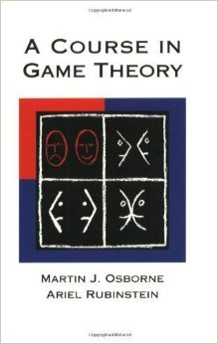
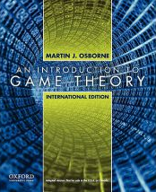
Textbook:
Osborne,Martin & Rubinstein,Ariel (OR)
A Course in Game Theory , MIT Press
Osborne,Martin, (OS)
An Introduction to Game Theory ,
Oxford university Press

Slide 5


What is
game Theory?
Rational individual
What is
game theory?
Max pay off

Slide 6
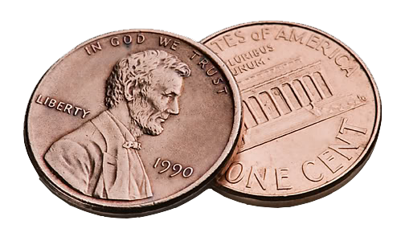
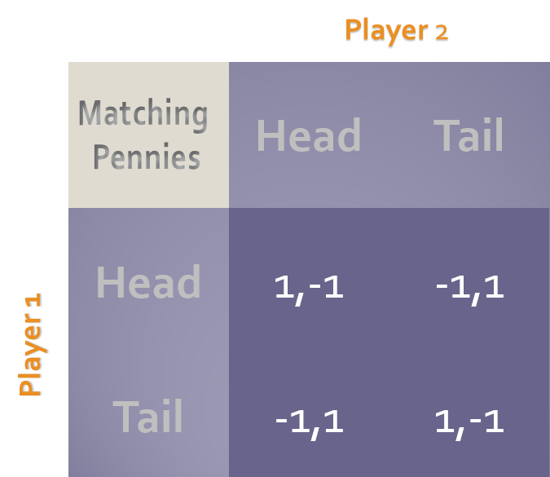
Game Components:
Players
Strategy ( Action )
Strategy Profile
Order of Play
Information set
Outcome
Payoff

Slide 7
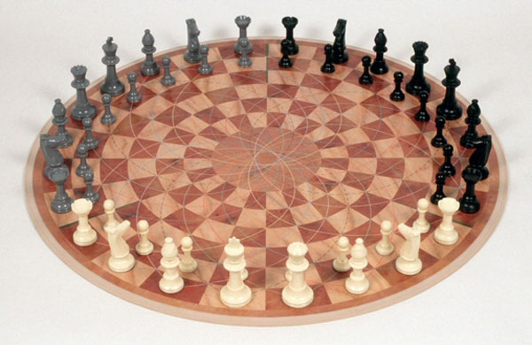
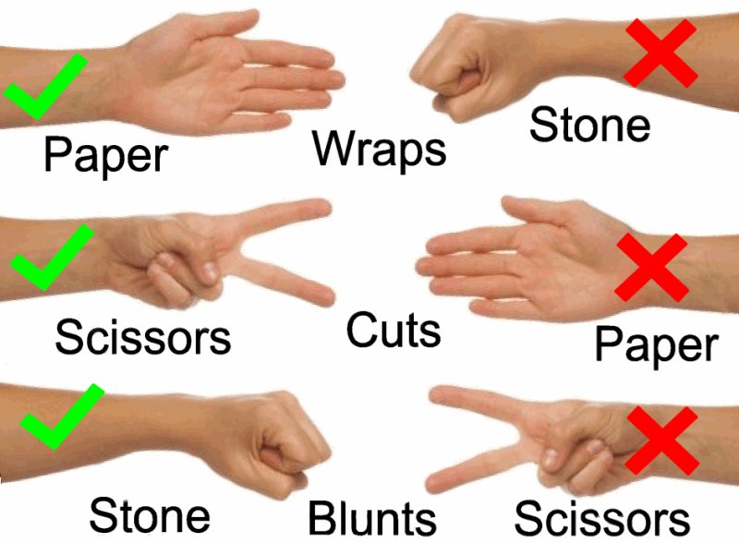
Game Components:
Strategy
Number of players
2 players
3 players
Rock, Scissors, Paper
Matching Pennies:
Matching Pennies:

Slide 8

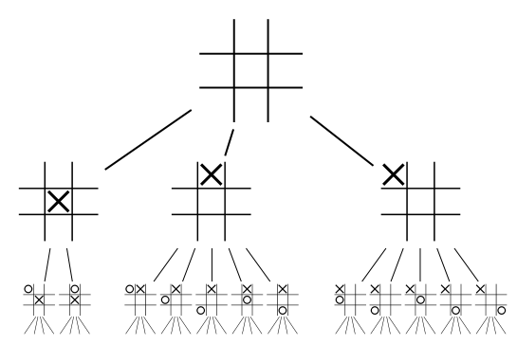
تعاریف
Simultaneous or Ordinal
Matching Pennies:
Dots & Crosses (Tick-Tack-Toe)

Slide 9
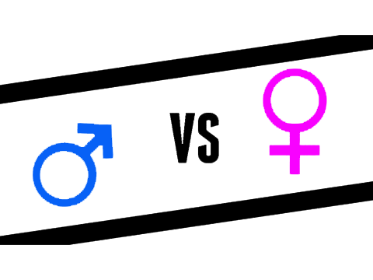

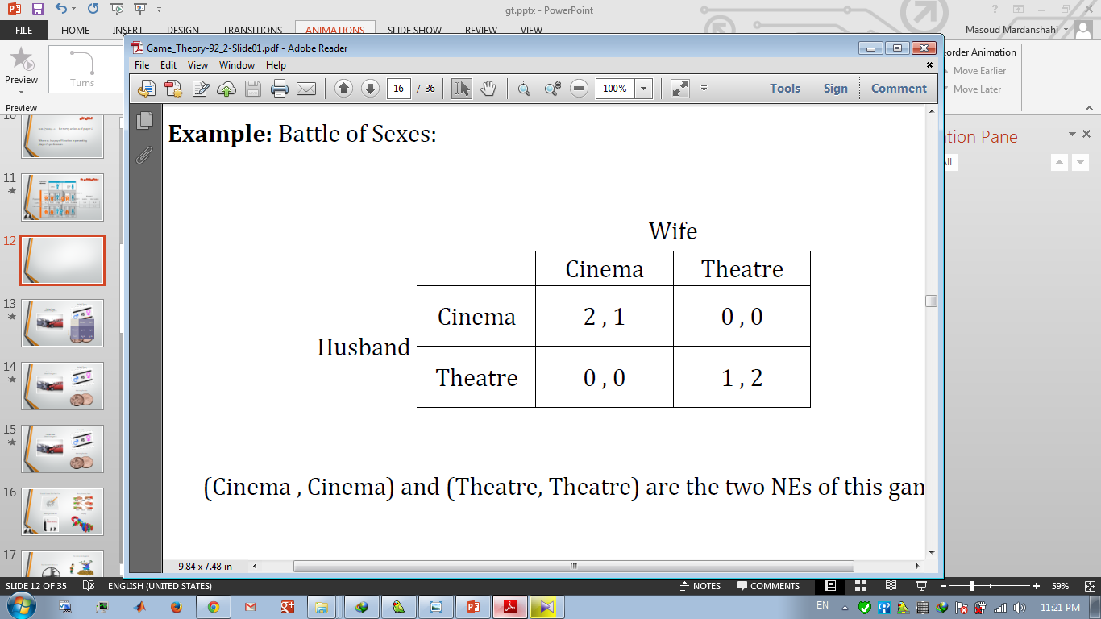
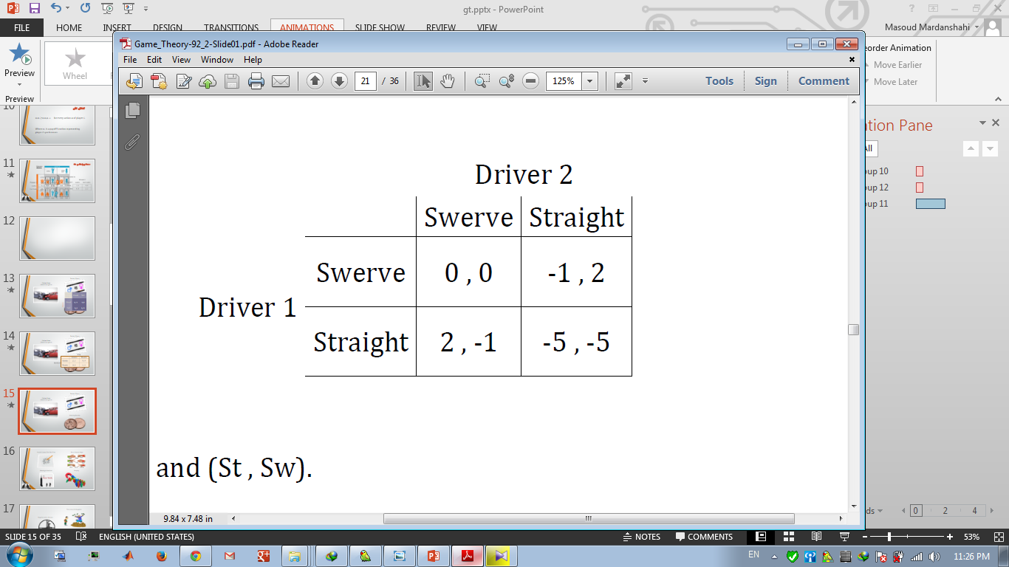
تعاریف
Cooperative
(Coalitional)
Non-Cooperative
Battle of Sexes:
Chicken Game
(Hawk-Dove game)

Slide 10
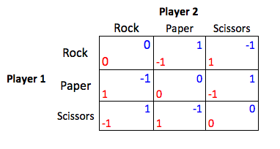
تعاریف
Strategic or Extensive
Rock, Scissors, Paper
Dots & Crosses (Tick-Tack-Toe)

Slide 11
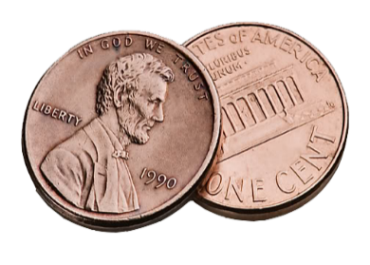

تعاریف
Zero-sum or Non Zero-sum

Slide 12
Nash
Equilibrium
𝑢𝑖 𝑎∗ ≥𝑢𝑖 𝑎𝑖,𝑎−𝑖∗ for every action 𝑎𝑖 of player 𝑖.
Where 𝑢𝑖. is a payoff function representing player 𝑖’s preferences

Slide 13
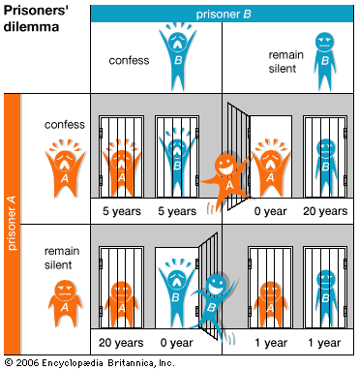
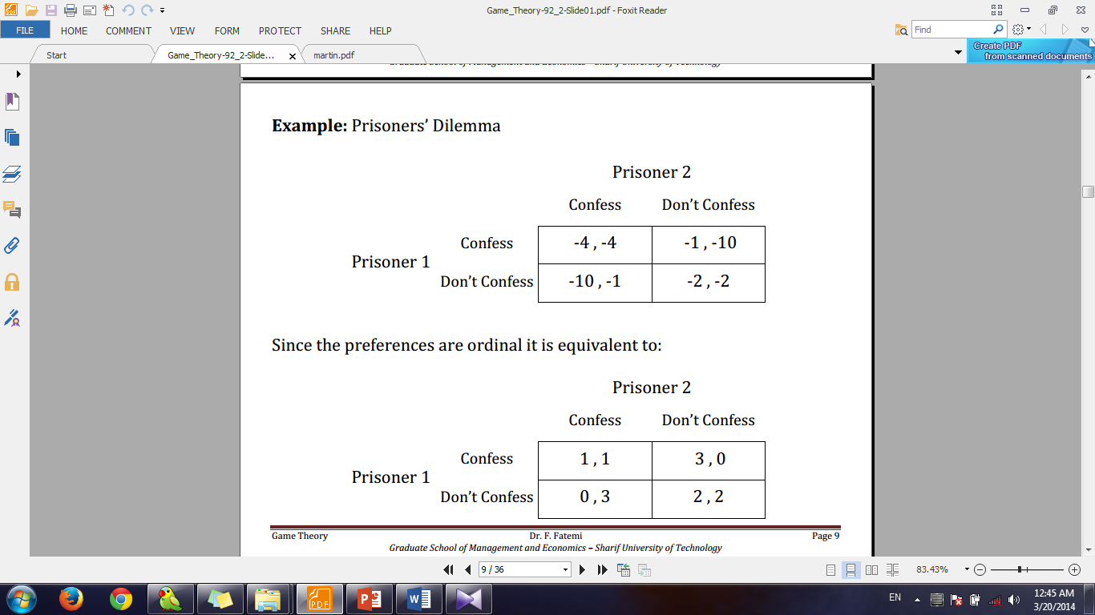
معمای زندانی ها:

Slide 14
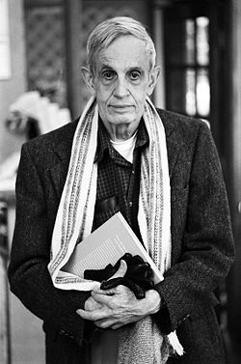
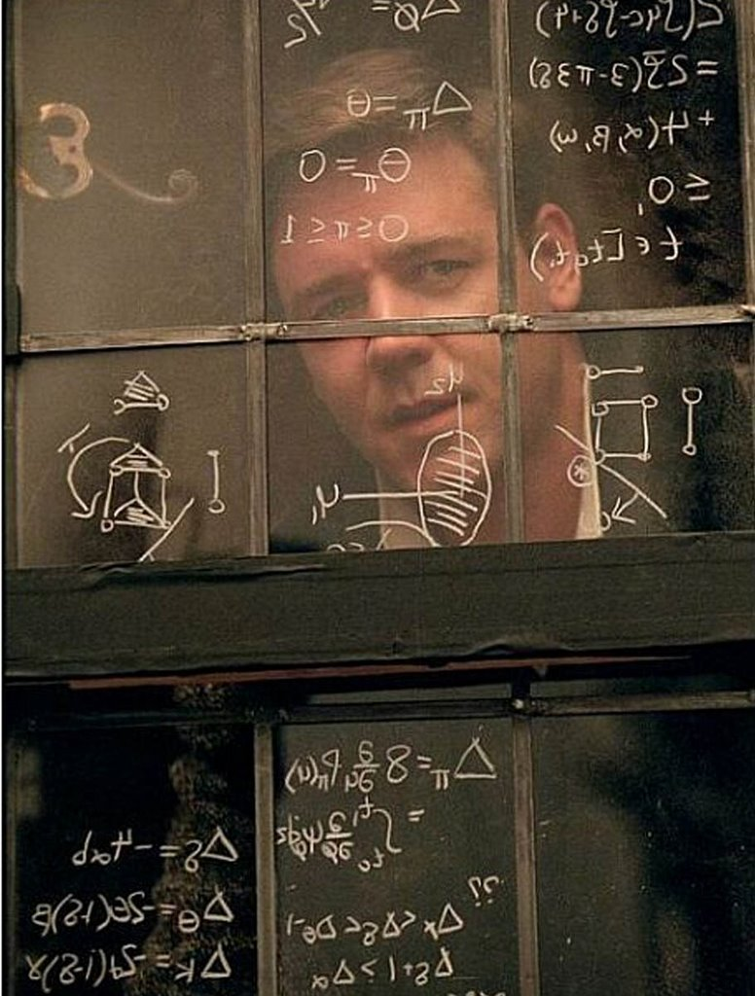
John Nash
Biography

Slide 15

Examples:
Chicken Game
(Hawk-Dove game)
Battle of Sexes:
The money sharing game:
Matching Pennies:

Slide 16
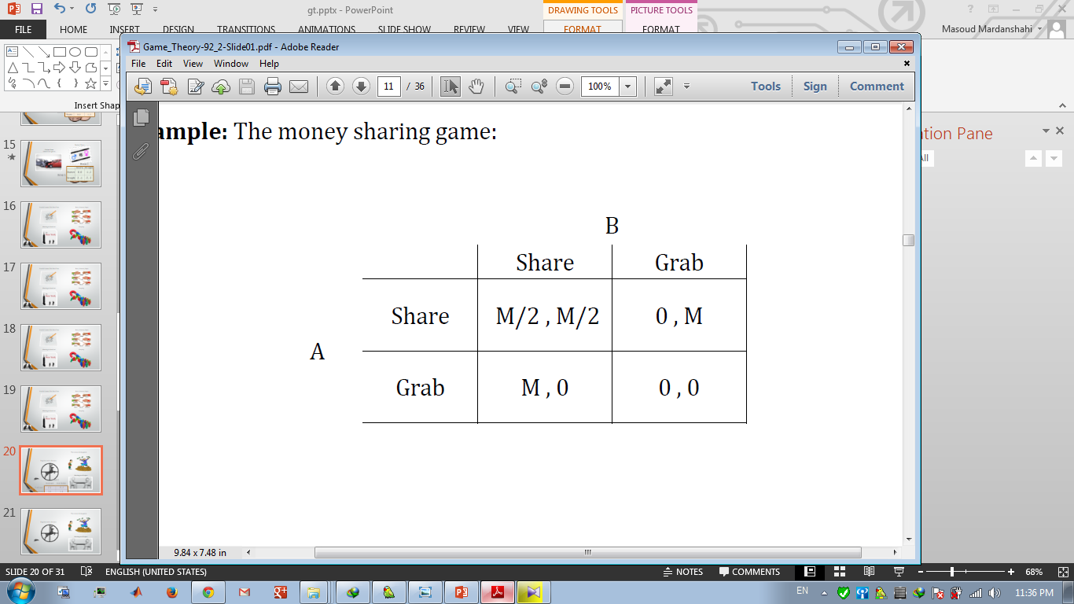
Examples:
Chicken Game
(Hawk-Dove game)
Battle of Sexes:
The money sharing game:

Slide 17
Examples:
Chicken Game
(Hawk-Dove game)
Battle of Sexes:

Slide 18
Examples:
Chicken Game
(Hawk-Dove game)

Slide 19
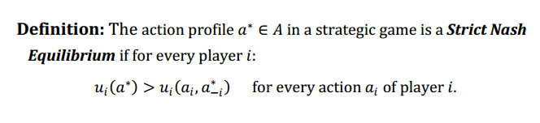
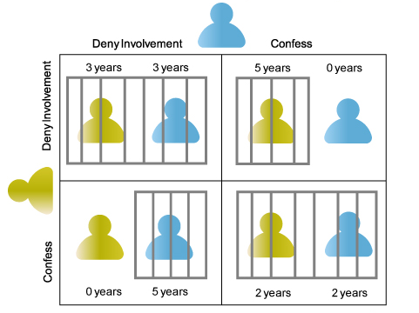
Strict Nash
Equilibrium
The money sharing game:

Slide 20
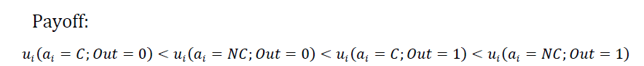
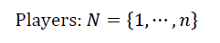
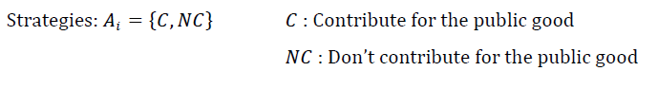
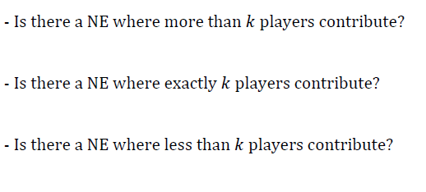


تامین کالای عمومی
Provision of
a Public Good
?

Slide 21
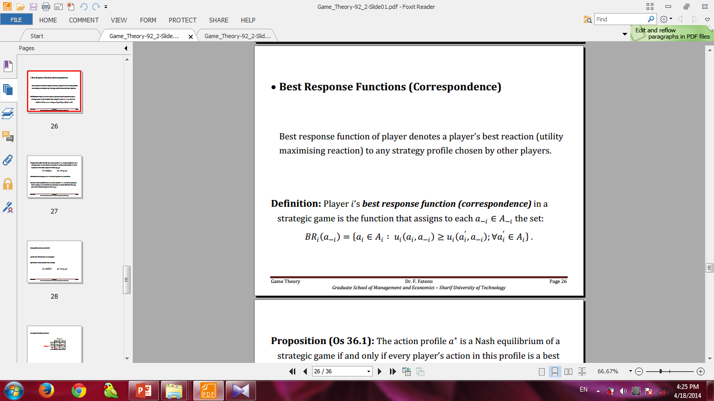
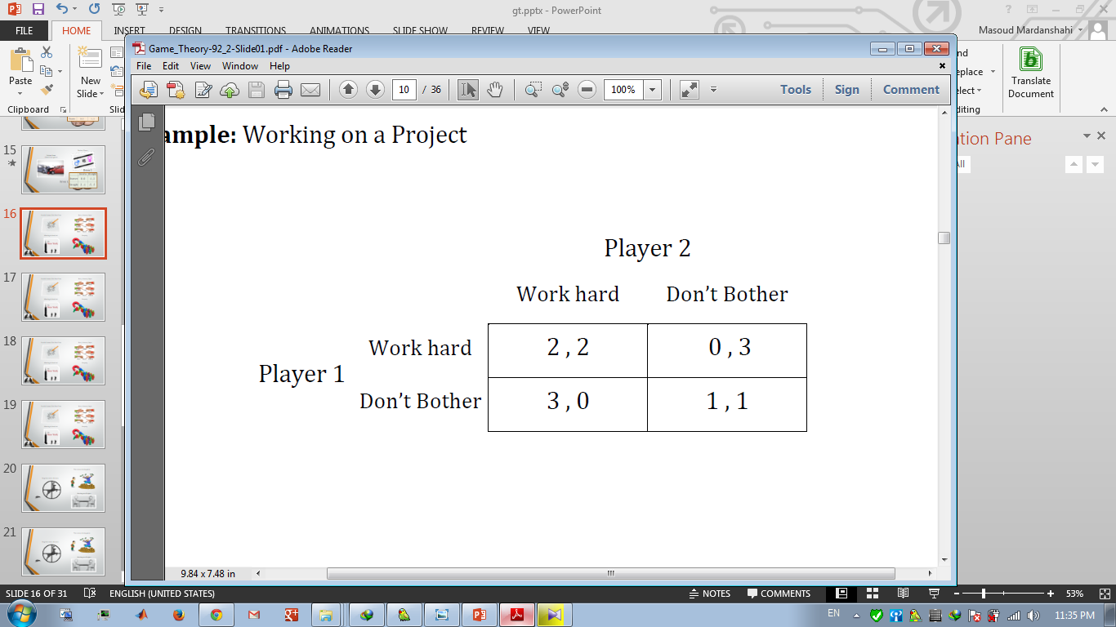
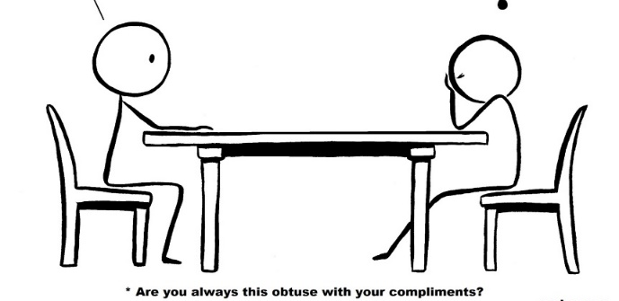
روش سریع تر یافتن تعادل نش
Best Response
Functions
Working on a Project

Slide 22
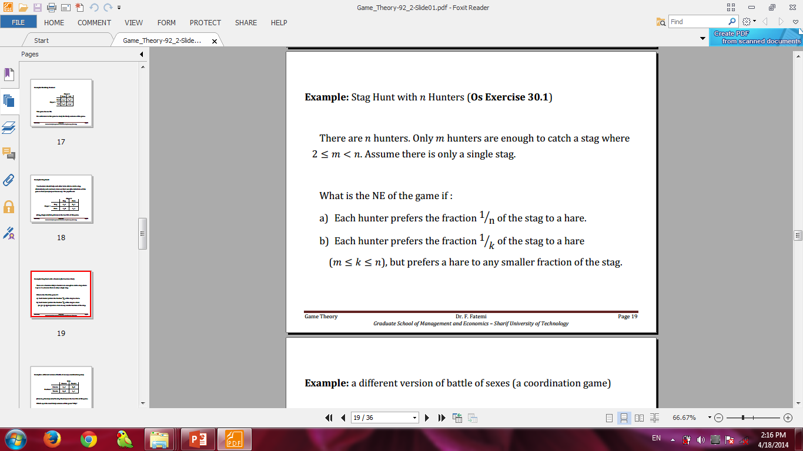
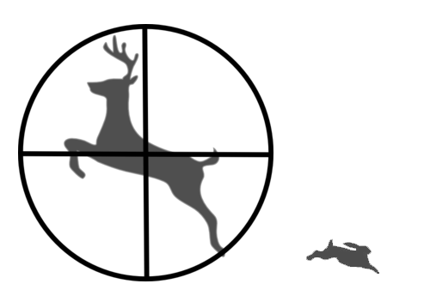
Using BR function
to find NE
Stag Hunt with n Hunters
Notes:
کدوم تعادل نشه؟

Slide 23
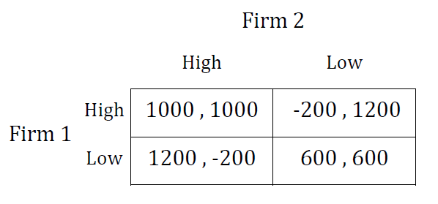

Duopoly

Slide 24
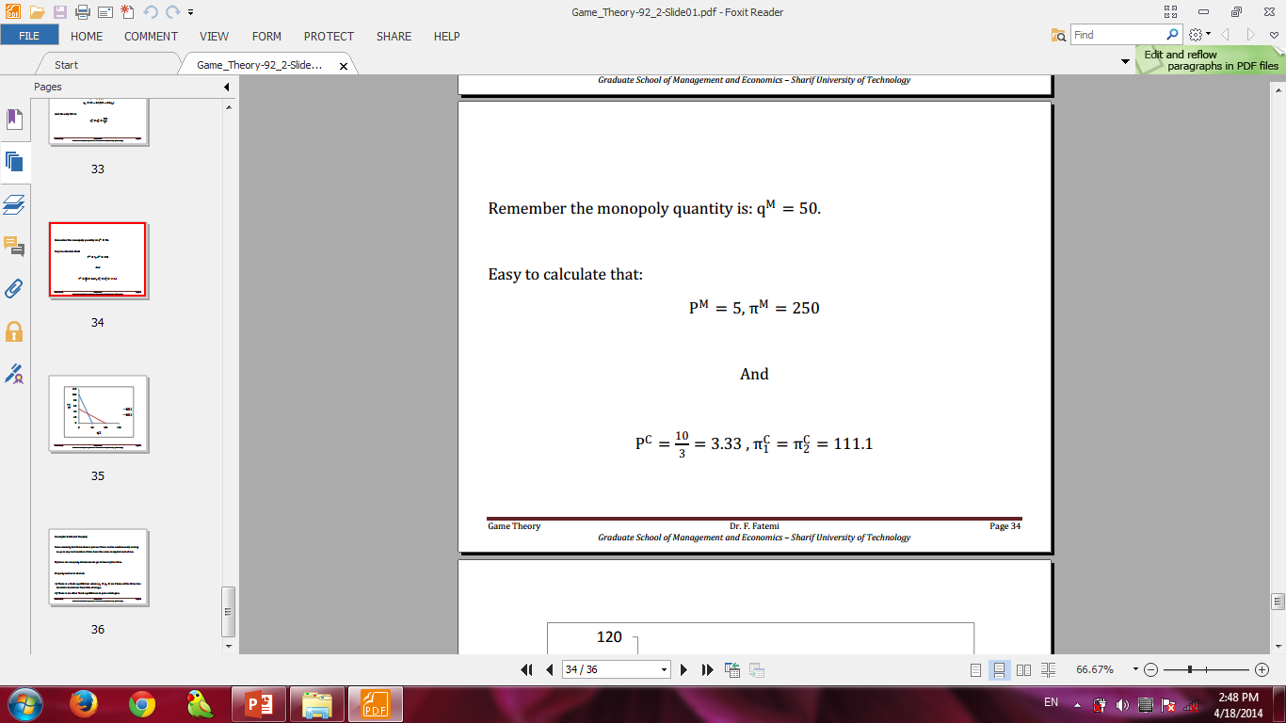
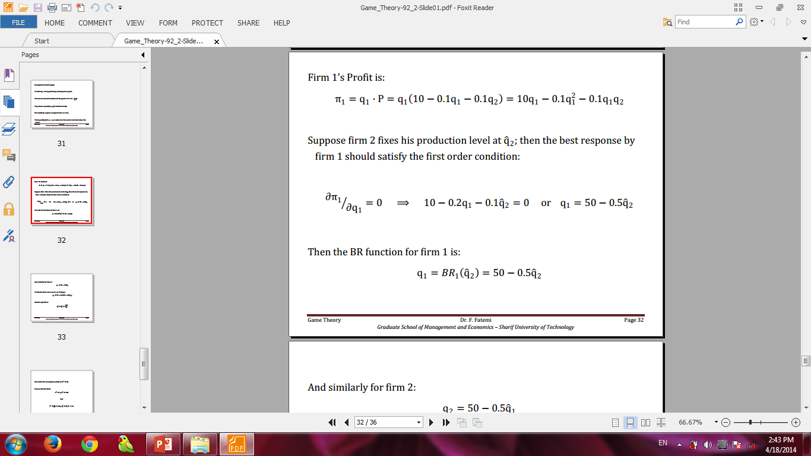
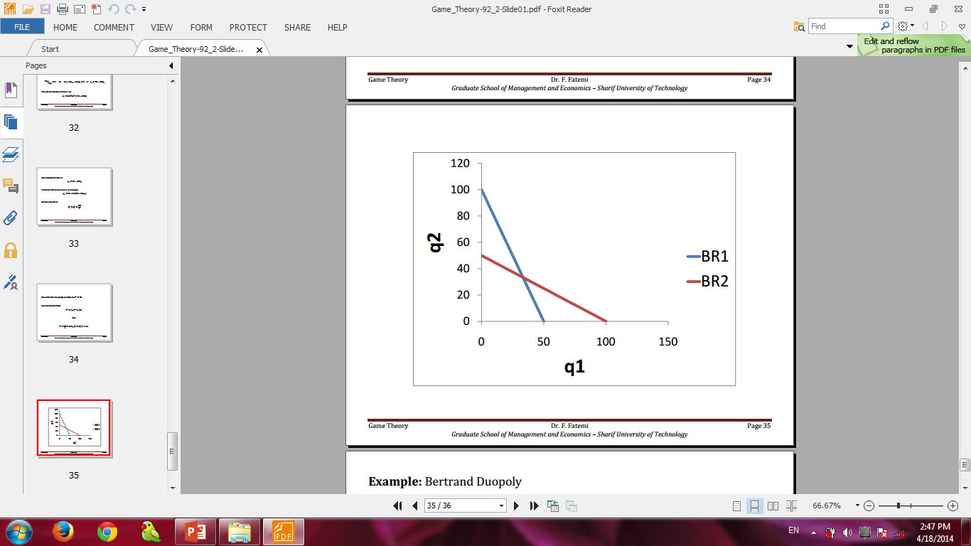
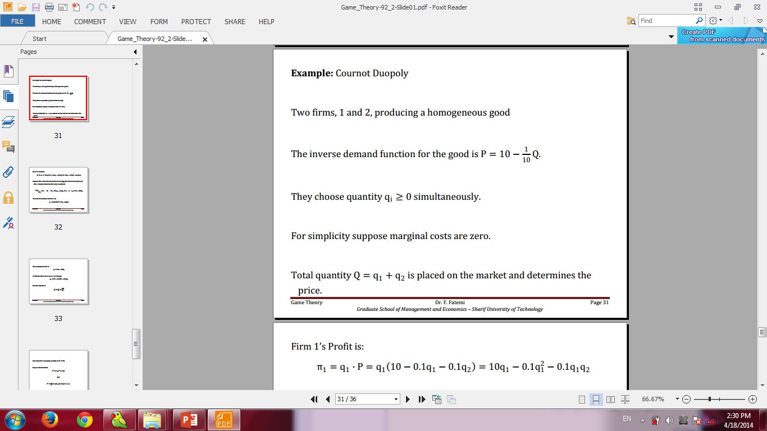
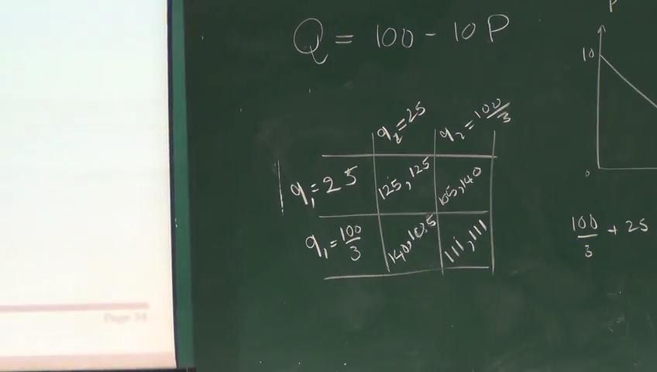

Cournat Duopoly
Notes:
دایلما
گذاشته شود

Slide 25
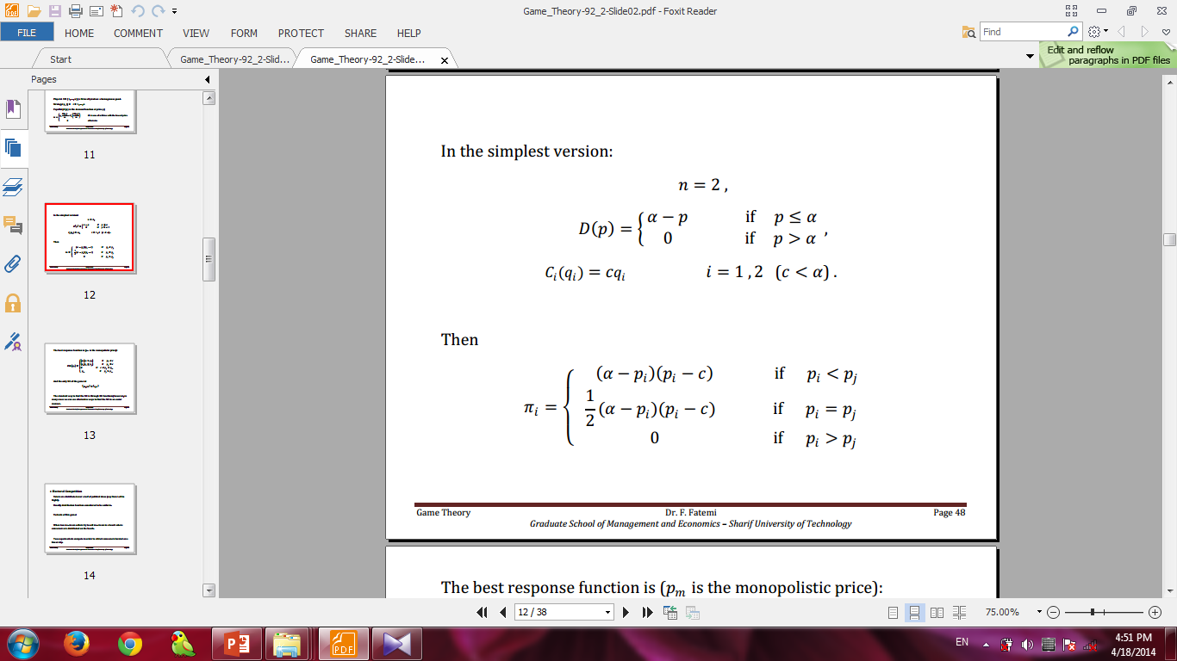
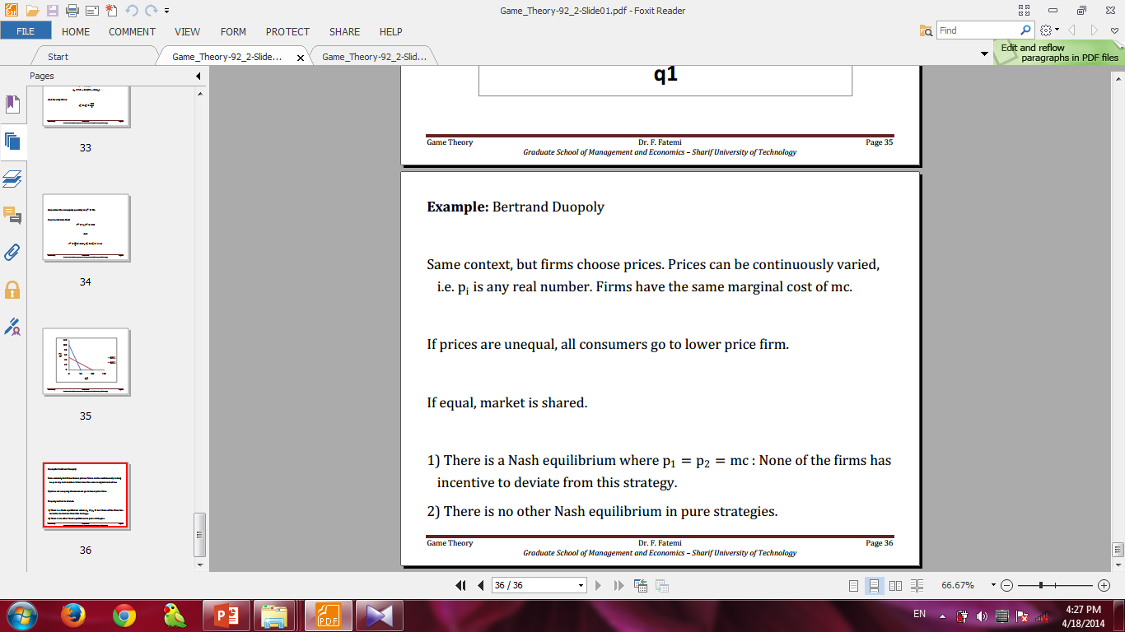
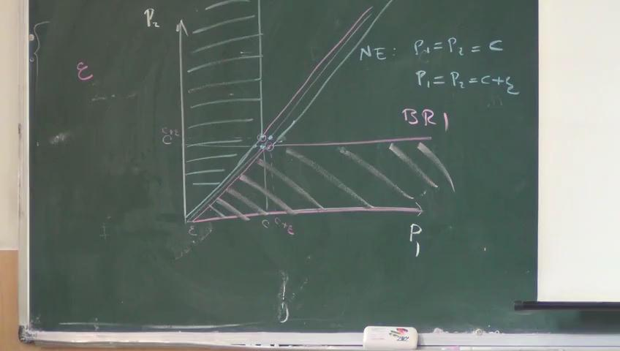
Bertrand Duopoly

Slide 26
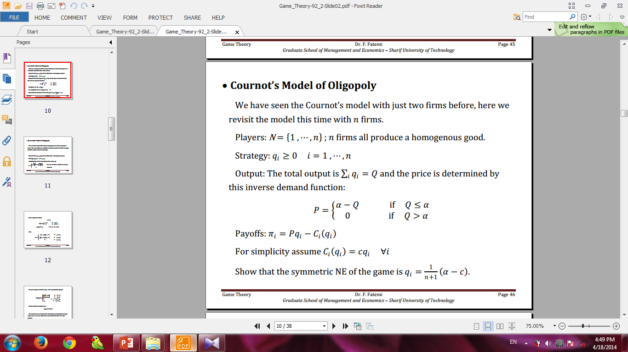
Cournat
oligopoly

Slide 27
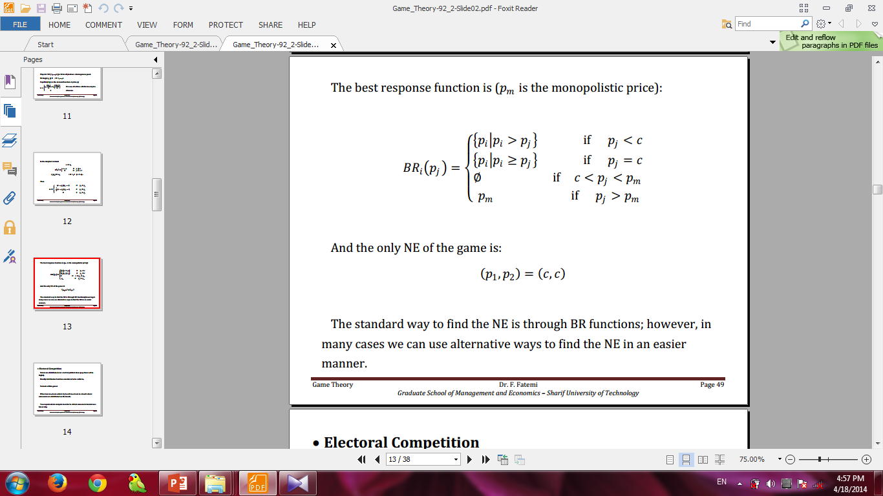
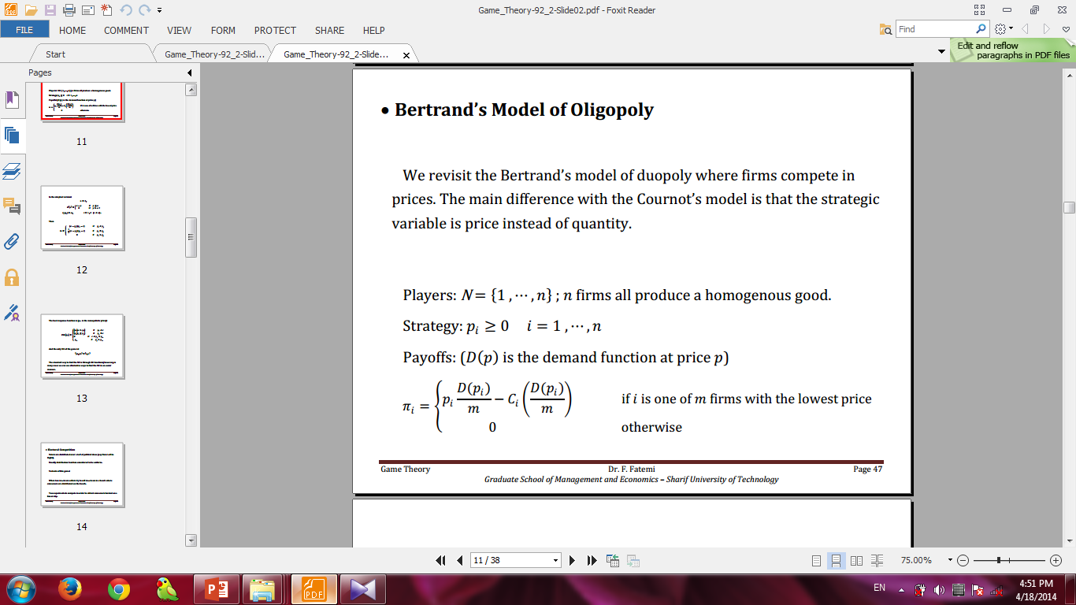
Bertrand
oligopoly

Slide 28
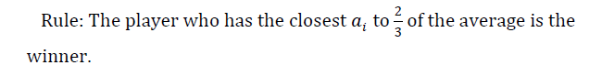
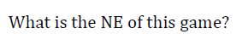
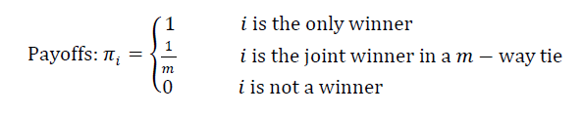
حدس دو سوم میانگین کلاس
Match

Slide 29
حراج ها
Auctions

Slide 30
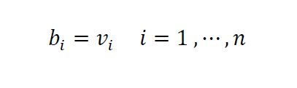
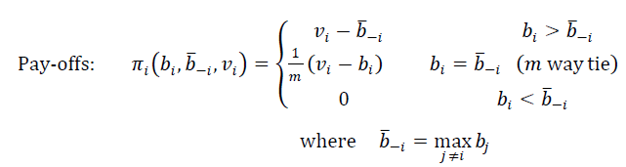
تعادل نش حراجی در کجا قرار دارد؟
Auctions
Strategy: bi≥0 i=1 ,⋯,n ; Each bidder submits a non-negative bid

Slide 31
منابع:
The End
محققان:
مسعود مردانشاهی-محمد حسن شماخی
mh.shammakhi@gmail.com
masoudm969@gmail.com
^ Roger B. Myerson (1991). Game Theory: Analysis of Conflict, Harvard University Press, p. 1. Chapter-preview links, pp. vii–xi.
Jump up^ R. J. Aumann ([1987] 2008). "game theory," Introduction, The New Palgrave Dictionary of Economics, 2nd Edition. Abstract.
^ Jump up to:ª ^{b} • Eric Rasmusen (2007). Games and Information, 4th ed. Description and chapter-preview. • David M. Kreps (1990). Game Theory and Economic Modelling. Description. • R. Aumann and S. Hart, ed. (1992, 2002). Handbook of Game Theory with Economic Applications v. 1, ch. 3–6 and v. 3, ch. 43.
^ Jump up to:ª ^{b} Colin F. Camerer (2003). Behavioral Game Theory: Experiments in Strategic Interaction, pp. 5–7 (scroll to at 1.1 What Is Game Theory Good For?).
Jump up^ Ross, Don. "Game Theory". The Stanford Encyclopedia of Philosophy (Spring 2008 Edition). Edward N. Zalta (ed.). Retrieved 2008-08-21.
Jump up^ Experimental work in game theory goes by many names, experimental economics, behavioral economics, and behavioural game theory are several. For a recent discussion, see Colin F. Camerer (2003). Behavioral Game Theory: Experiments in Strategic Interaction (description and Introduction, pp. 1–25).
Jump up^ • At JEL:C7 of the Journal of Economic Literature classification codes. • R.J. Aumann (2008). "game theory," The New Palgrave Dictionary of Economics, 2nd Edition.Abstract. • Martin Shubik (1981). "Game Theory Models and Methods in Political Economy," in Kenneth Arrow and Michael Intriligator, ed., Handbook of Mathematical Economics, v. 1, pp. 285–330doi:10.1016/S1573-4382(81)01011-4. • Carl Shapiro (1989). "The Theory of Business Strategy," RAND Journal of Economics, 20(1), pp. 125–137 JSTOR 2555656.
Jump up^ N. Agarwal and P. Zeephongsekul. Psychological Pricing in Mergers & Acquisitions using Game Theory, School of Mathematics and Geospatial Sciences, RMIT University, Melbourne
Jump up^ • Leigh Tesfatsion (2006). "Agent-Based Computational Economics: A Constructive Approach to Economic Theory," ch. 16, Handbook of Computational Economics, v. 2, pp. 831-880doi:10.1016/S1574-0021(05)02016-2. • Joseph Y. Halpern (2008). "computer science and game theory," The New Palgrave Dictionary of Economics, 2nd Edition. Abstract.
Jump up^ • From The New Palgrave Dictionary of Economics (2008), 2nd Edition: Roger B. Myerson. "mechanism design." Abstract. _____. "revelation principle." Abstract. • Tuomas Sandholm. "computing in mechanism design." Abstract. • Noam Nisan and Amir Ronen (2001). "Algorithmic Mechanism Design," Games and Economic Behavior, 35(1–2), pp. 166–196. • Noam Nisan et al., ed. (2007). Algorithmic Game Theory, Cambridge University Press.Description.
Jump up^ R. Aumann and S. Hart, ed., 1994. Handbook of Game Theory with Economic Applications, v. 2, outline links, ch. 30: "Voting Procedures" & ch. 31: "Social Choice."
Jump up^ • Vernon L. Smith, 1992. "Game Theory and Experimental Economics: Beginnings and Early Influences," in E. R. Weintraub, ed., Towards a History of Game Theory, pp. 241–282. • _____, 2001. "Experimental Economics," International Encyclopedia of the Social & Behavioral Sciences, pp. 5100–5108. Abstract per sect. 1.1 & 2.1. • Charles R. Plott and Vernon L. Smith, ed., 2008. Handbook of Experimental Economics Results, v. 1, Elsevier, Part 4, Games, ch. 45–66. • Vincent P. Crawford (1997). "Theory and Experiment in the Analysis of Strategic Interaction," inAdvances in Economics and Econometrics: Theory and Applications, pp. 206–242. Cambridge. Reprinted in Colin F. Camerer et al., ed. (2003). Advances in Behavioral Economics, Princeton. 1986–2003 papers. Description, preview, Princeton, ch. 12. • Martin Shubik, 2002. "Game Theory and Experimental Gaming," in R. Aumann and S. Hart, ed.,Handbook of Game Theory with Economic Applications, Elsevier, v. 3, pp. 2327–2351.doi:10.1016/S1574-0005(02)03025-4.
Jump up^ From The New Palgrave Dictionary of Economics (2008), 2nd Edition: • Faruk Gul. "behavioural economics and game theory." Abstract. • Colin F. Camerer. "behavioral game theory." Abstract. • _____ (1997). "Progress in Behavioral Game Theory," Journal of Economic Perspectives, 11(4), p. 172, pp. 167–188. • _____ (2003). Behavioral Game Theory, Princeton. Description, preview ([ctrl]+), and ch. 1 link. • _____, George Loewenstein, and Matthew Rabin, ed. (2003). Advances in Behavioral Economics, Princeton. 1986–2003 papers. Description, contents, and preview. • Drew Fudenberg (2006). "Advancing Beyond Advances in Behavioral Economics," Journal of Economic Literature, 44(3), pp. 694–711 JSTOR 30032349.
Jump up^ • Jean Tirole (1988). The Theory of Industrial Organization, MIT Press. Description and chapter-preview links, pp. vii–ix, "General Organization," pp. 5–6, and "Non-Cooperative Game Theory: A User's Guide Manual,' " ch. 11, pp. 423–59. • Kyle Bagwell and Asher Wolinsky (2002). "Game theory and Industrial Organization," ch. 49,Handbook of Game Theory with Economic Applications, v. 3, pp. 1851–1895. • Martin Shubik (1959). Strategy and Market Structure: Competition, Oligopoly, and the Theory of Games, Wiley. Description and review extract. • _____ with Richard Levitan (1980). Market Structure and Behavior, Harvard University Press. Review extract.
Jump up^ • Martin Shubik (1981). "Game Theory Models and Methods in Political Economy," in Handbook of Mathematical Economics, v. 1, pp. 285–330 doi:10.1016/S1573-4382(81)01011-4. •_____ (1987). A Game-Theoretic Approach to Political Economy. MIT Press. Description.
Jump up^ • Martin Shubik (1978). "Game Theory: Economic Applications," in W. Kruskal and J.M. Tanur, ed., International Encyclopedia of Statistics, v. 2, pp. 372–78. • Robert Aumann and Sergiu Hart, ed. Handbook of Game Theory with Economic Applications(scrollable to chapter-outline or abstract links):
1992. v. 1; 1994. v. 2; 2002. v. 3.
Jump up^ Game-theoretic model to examine the two tradeoffs in the acquisition of information for a careful balancing act Research paper INSEAD
Jump up^ Options Games: Balancing the trade-off between flexibility and commitment. Europeanfinancialreview.com (2012-02-15). Retrieved on 2013-01-03.
Jump up^ Morrison, Andrew Stumpff, Eminent Legal Philosophers, or Yes, Law is the Command of the Sovereign, at 8-12 (2013). Available at SSRN: http://ssrn.com/abstract=2371076
Jump up^ Wood, Peter John. (2011, February). "Climate change and game theory," Ecological Economics Review 1219: 153-70.
Jump up^ Maynard Smith, J. (1974). "The theory of games and the evolution of animal conflicts". Journal of Theoretical Biology 47 (1): 209–221. doi:10.1016/0022-5193(74)90110-6. PMID 4459582. edit
Jump up^ Evolutionary Game Theory (Stanford Encyclopedia of Philosophy). Plato.stanford.edu. Retrieved on 2013-01-03.
^ Jump up to:ª ^{b} Biological Altruism (Stanford Encyclopedia of Philosophy). Seop.leeds.ac.uk. Retrieved on 2013-01-03.
Jump up^ Noam Nisan et al., ed. (2007). Algorithmic Game Theory, Cambridge University Press. Description.
Jump up^ Nisan, Noam; Ronen, Amir (2001), "Algorithmic Mechanism Design", Games and Economic Behavior 35 (1–2): 166–196, doi:10.1006/game.1999.0790
Jump up^ • Joseph Y. Halpern (2008). "computer science and game theory," The New Palgrave Dictionary of Economics, 2nd Edition. Abstract. • Shoham, Yoav (2008), "Computer Science and Game Theory", Communications of the ACM 51(8): 75–79, doi:10.1145/1378704.1378721 • Littman, Amy; Littman, Michael L. (2007), "Introduction to the Special Issue on Learning and Computational Game Theory", Machine Learning 67 (1–2): 3–6, doi:10.1007/s10994-007-0770-1
Jump up^ Ullmann-Margalit, E. (1977), The Emergence of Norms, Oxford University Press,ISBN 0198244118
Jump up^ Bicchieri, C. (2006), The Grammar of Society: the Nature and Dynamics of Social Norms, Cambridge University Press, ISBN 0521573726
Jump up^ Bicchieri, Cristina (1989), "Self-Refuting Theories of Strategic Interaction: A Paradox of Common Knowledge", Erkenntnis 30 (1–2): 69–85, doi:10.1007/BF00184816 See also Rationality and Coordination, Cambridge University Press, 1993, ISBN 0521381231
Jump up^ The Dynamics of Rational Deliberation, Harvard University Press, 1990, ISBN 067421885X
Jump up^ Bicchieri, Cristina; Jeffrey, Richard; Skyrms, Brian, eds. (1999), "Knowledge, Belief, and Counterfactual Reasoning in Games", The Logic of Strategy, New York: Oxford University Press,ISBN 0195117158
Jump up^ For a more detailed discussion of the use of Game Theory in ethics see the Stanford Encyclopedia of Philosophy's entry game theory and ethics.
Jump up^ Harold Houba, Wilko Bolt. Credible Threats in Negotiations. A Game-theoretic Approach. Chapter 4. The Nash Program. ISBN 978-1-4020-7183-6.
^ Jump up to:ª ^{b} Jörg Bewersdorff (2005), Luck, logic, and white lies: the mathematics of games, A K Peters, Ltd., pp. ix–xii and chapter 31, ISBN 978-1-56881-210-6
Jump up^ Albert, Michael H.; Nowakowski, Richard J.; Wolfe, David (2007), Lessons in Play: In Introduction to Combinatorial Game Theory, A K Peters Ltd, pp. 3–4, ISBN 978-1-56881-277-9
Jump up^ Beck, József (2008), Combinatorial games: tic-tac-toe theory, Cambridge University Press, pp. 1–3,ISBN 978-0-521-46100-9
Jump up^ Robert A. Hearn; Erik D. Demaine (2009), Games, Puzzles, and Computation, A K Peters, Ltd.,ISBN 978-1-56881-322-6
Jump up^ Petrosjan, L.A. and Murzov, N.V. (1966). Game-theoretic problems of mechanics. Litovsk. Mat. Sb. 6, 423–433 (in Russian).
^ Jump up to:ª ^{b} Hugh Brendan McMahan (2006), Robust Planning in Domains with Stochastic Outcomes, Adversaries, and Partial Observability, CMU-CS-06-166, pp. 3–4
^ Jump up to:ª ^{b} Bellhouse, David (2007), "The Problem of Waldegrave", Journal Électronique d'Histoire des Probabilités et de la Statistique 3 (2)
Jump up^ James Madison, Vices of the Political System of the United States, April 1787. Link
Jump up^ Jack Rakove, "James Madison and the Constitution", History Now, Issue 13 September 2007. Link
Jump up^ Neumann, J. v. (1928), "Zur Theorie der Gesellschaftsspiele", Mathematische Annalen 100 (1): 295–320, doi:10.1007/BF01448847 English translation: Tucker, A. W.; Luce, R. D., eds. (1959),"On the Theory of Games of Strategy", Contributions to the Theory of Games 4, pp. 13–42
Jump up^ Leonard, Robert (2010), Von Neumann, Morgenstern, and the Creation of Game Theory, New York: Cambridge University Press, ISBN 9780521562669
Jump up^ Although common knowledge was first discussed by the philosopher David Lewis in his dissertation (and later book) Convention in the late 1960s, it was not widely considered by economists until Robert Aumann's work in the 1970s.
Jump up^ Simon Singh "Between Genius and Madness." New York Times (June 14, 1998)
Jump up^ M. Tim Jones (2008), Artificial Intelligence: A Systems Approach, Jones & Bartlett Learning, pp. 106–118, ISBN 978-0-7637-7337-3
Jump up^ Sylvia Nasar, A Beautiful Mind, (1998). Simon & Schuster. ISBN 0-684-81906-6
Jump up^ Heinlein, Robert A. (1959), Starship Troopers

